Slide 1

CAPSTONE PROJECT
End-to-End Automation Testing & Agile Development
| Python | SQL | Appium | CI/CD
REDDI SANDEEP KUMAR,
SENIOR ASSOCIATE ENGINEER,
ASCENDION

Slide 2

Project Introduction
Full-stack QA + development project
Covered Manual Testing with JIRA, Automation Testing (using Selenium + Python + Pytest), SQL, Python OOP, Appium, CI/CD
Implemented on:
Live e-commerce website: demowebshop.tricentis.com
Android app: KWADemo
Python Banking Application (OOP)
PostgreSQL Database Operations
Appium Mobile Automation
GitHub + GitHub Actions CI/CD
Goal: Demonstrate complete QA lifecycle + automation + development + DevOps integration

Slide 3
Tools & Technologies
Programming Language: Python
  Automation: Selenium WebDriver, Pytest
  Mobile Automation: Appium
  DevOps: GitHub Actions
  Test Management: Jira
  Database: PostgreSQL
  IDE: PyCharm
  Version Control: GitHub

Slide 4
Manual Testing with Jira
Jira is a project management and issue-tracking tool that teams use to plan, track, and manage software development work. For testing, Jira allows you to create, organize, and link test cases with user stories using plugins like Zephyr or Xray.
Created 10+ test cases for Ecommerce website
Linked test cases with requirements
Executed tests in Jira test execution cycle
Marked results as Pass / Fail
Logged bugs with:
Expected & actual behaviour
Screenshots

Slide 5
Automation Testing (Selenium + Python + Pytest)
Automation Testing with Selenium (using Python and Pytest) involves writing scripts to automatically interact with web applications—clicking elements, entering data, and validating results. Selenium handles browser automation, while Pytest provides a simple, powerful framework for organizing, running, and reporting test cases. This combination improves test speed, accuracy, and coverage compared to manual testing.
Implemented 3 frameworks: Page Object Model (POM), Data-Driven Framework,
Modular Framework
Project Website: https://demowebshop.tricentis.com/

Slide 6
Python Banking Application (OOP)
Developed a console-based banking system
Implemented OOP concepts:
Classes & Objects
Encapsulation
Abstraction
Inheritance & Polymorphism
Features implemented:
Customer creation
Account creation
Deposit / Withdrawal
Balance check

Slide 7
SQL Queries (PostgreSQL)
Performed SQL operations for banking system:
  Created tables and Performed CRUD operations, joins and used DDL, DML, DQL queries
Appium Mobile Automation
Appium is an open-source tool used for automating mobile applications on Android and iOS. It allows you to write tests using any programming language and run them on real devices or emulators. With Appium, testers can validate UI interactions, functionality, and performance just like a real user.
Tools: Appium Server + Emulator + KWADemo App

Slide 8
GitHub Version Control
GitHub is a cloud-based platform for hosting and managing code repositories using Git version control. It allows teams to collaborate, track changes, review code, and manage project workflows.
Challenges Faced:
GitHub Actions failed because browser was set to GUI mode:
Fix: Change headless = true
Fixing Stale Element Exceptions: While opening search results, DOM refreshed → stale element error.
Fix: Re-fetch elements after DOM reload:

Slide 9
Key Learnings
Complete SDLC & STLC
POM & Data-Driven automation
CI/CD pipeline setup
Python OOP design
SQL database design
Appium mobile automation
Git best practices
Debugging real-time issues

Slide 10
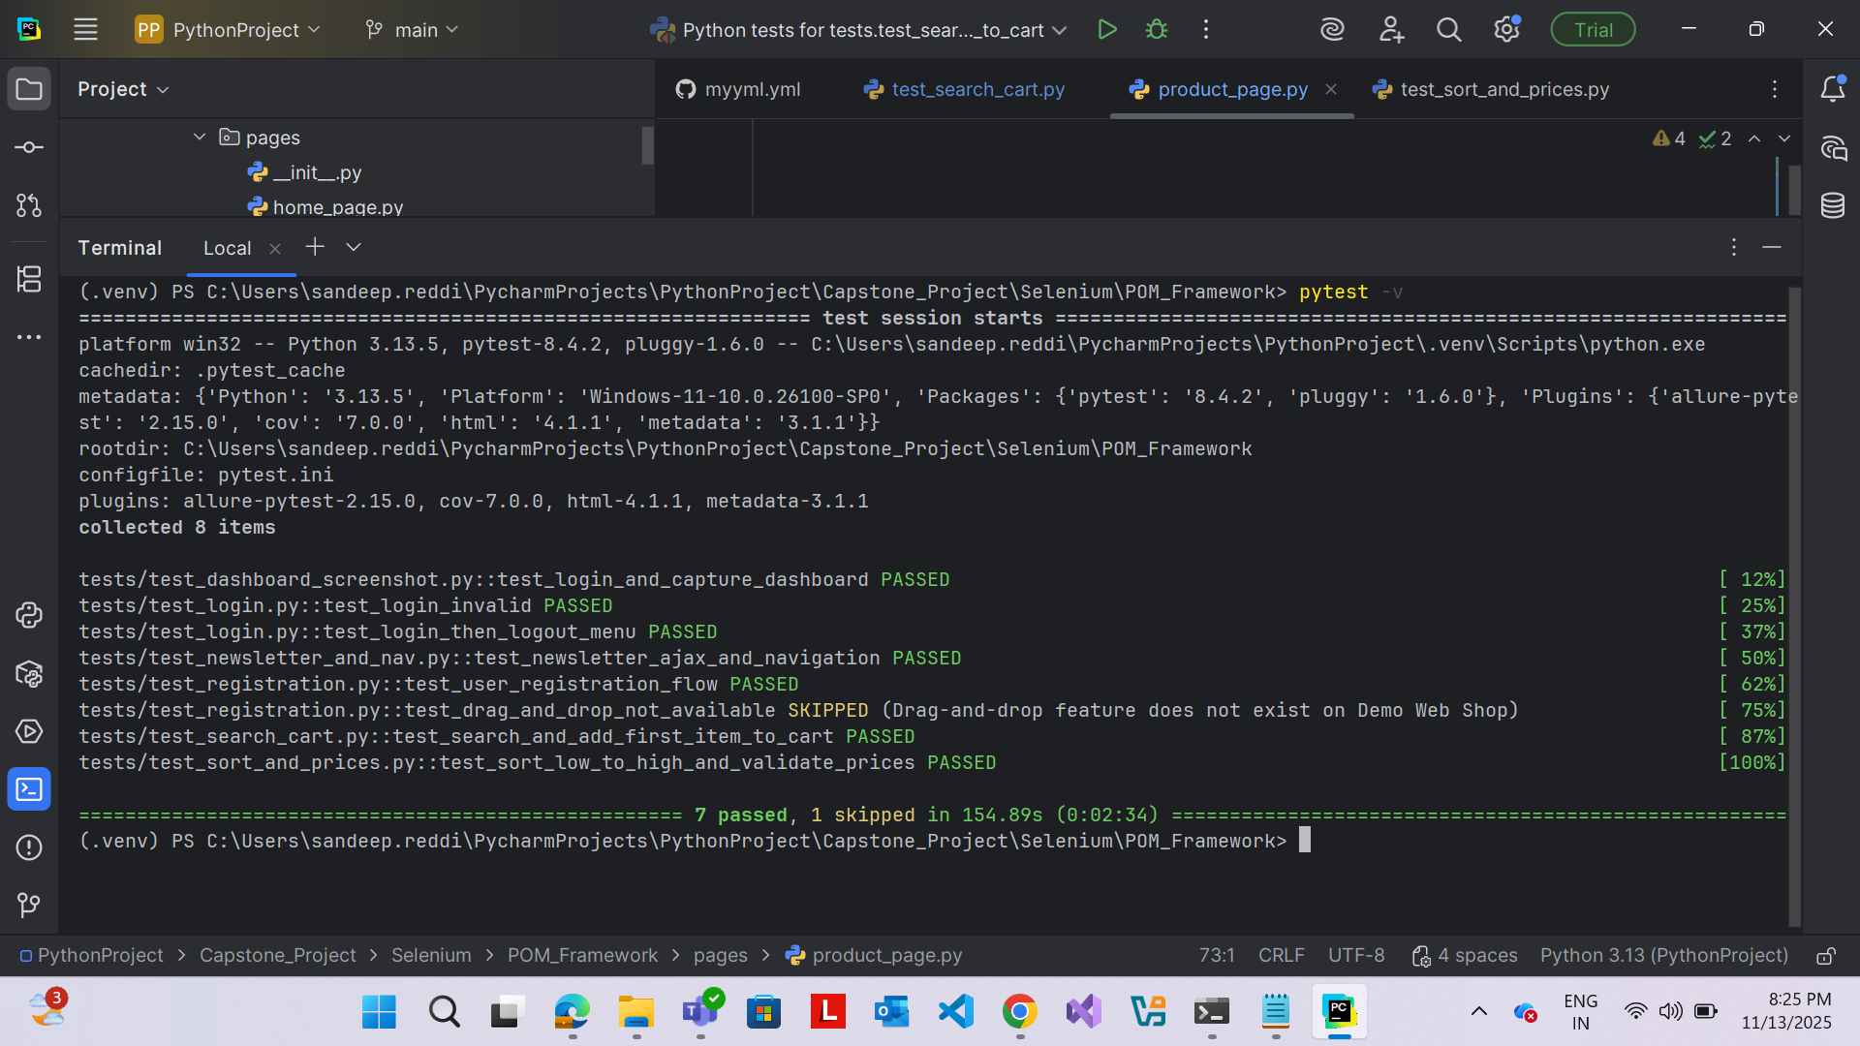
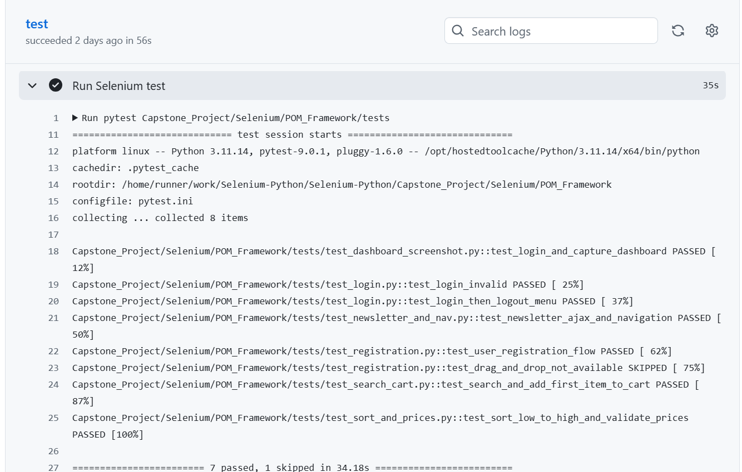

Slide 11
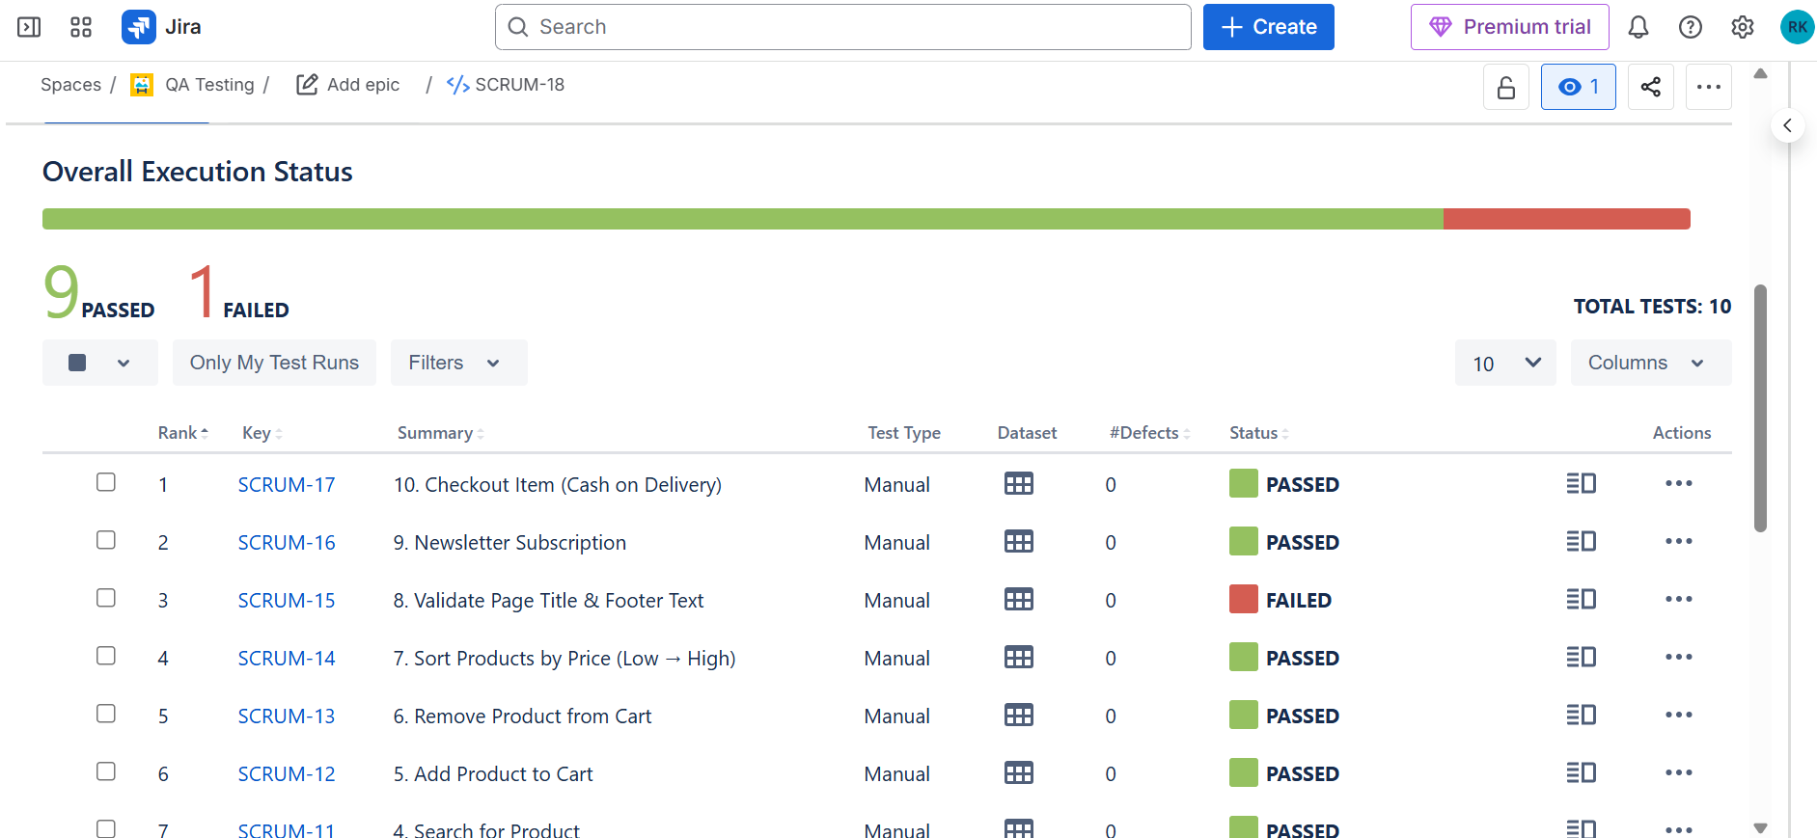

Slide 12
Conclusion:
Demonstrated an end-to-end QA + Automation + Development + DevOps workflow
Built scalable frameworks
Executed automation on web + mobile
Integrated database + OOP application
Implemented CI/CD pipeline with GitHub Actions

Slide 13
Thank you....

